Slide 1

Practice of Deep Learning Course Introduction
Matthieu De Mari

Slide 2

A quick word about instructors
Matthieu (Matt) De Mari
Director (Master of Science in Design and Artificial Intelligence for Enterprise)
Senior Lecturer at SUTD (Python, Deep Learning, Prog. Language Concepts, Capstone, etc.)
PhD from CentraleSupelec (France)
Email: matthieu_demari@sutd.edu.sg
Office @ SUTD (in SUTD Academy/AI cluster): 2.401-07.

Slide 3
Objectives of this course
Introduce the technical aspects related to the implementation of Deep Neural Networks, a.k.a. Deep Learning.
Teach the students about the most popular framework for implementing Deep Neural Networks (as of Jan 2025): PyTorch.
Discuss the mathematical foundations and intuitions behind Deep Learning tools, layers and techniques.
Give the students a global overview of the foundational and advanced techniques related to Deep Learning and Neural Networks.
Describe examples of practical applications of Deep Learning, showing how some key AI tools are implemented.

Slide 4
Skills needed for this course
Must-have CS: Python, Numpy, Matplotlib.
Must-have Math: Linear Algebra, Multiple Variables Calculus, Differentiation/Derivatives, Optimization.
Good-to-have CS: Machine Learning, Data Processing, Pandas, Scipy, Sklearn.
Good-to-have Math: Probabilities and Statistics, Graph Theory.
Need to revise? Feel free to check your previous courses, we are going to build upon them!

Slide 5
The way we teach things
An expert is not someone who
Took a 6h-long online video course,
Implements Neural Networks by randomly connecting basic layers (typically Linear and Conv),
Uses a random framework they do not understand (or autoML!),
Cannot obtain more than 90% accuracy on a simple dataset like MNIST or CIFAR-10.
An expert is someone who
Understands how Neural Networks operate and the mathematical intuition behind why typical operations used in layers,
Understands how the frameworks have been built and what they do behind the scenes,
Understands that AI is a fast-evolving field and knows how to stay up to date when it comes to AI.

Slide 6
The way we teach things
Lectures slides, along with supporting notebooks.
Mathematical aspects discussed in class (to show what is happening behind the scenes of Neural Networks/Deep Learning).
Made a choice: providing lots of code to demonstrate concepts but might need you to play with them autonomously!
Extra reading, for curiosity (supporting papers, articles, etc.) and suggestions of pointers to stay up-to-date.
Suggestions on how to continue your learning, after this course.
(If time allows, sharing some video recordings as well).

Slide 7
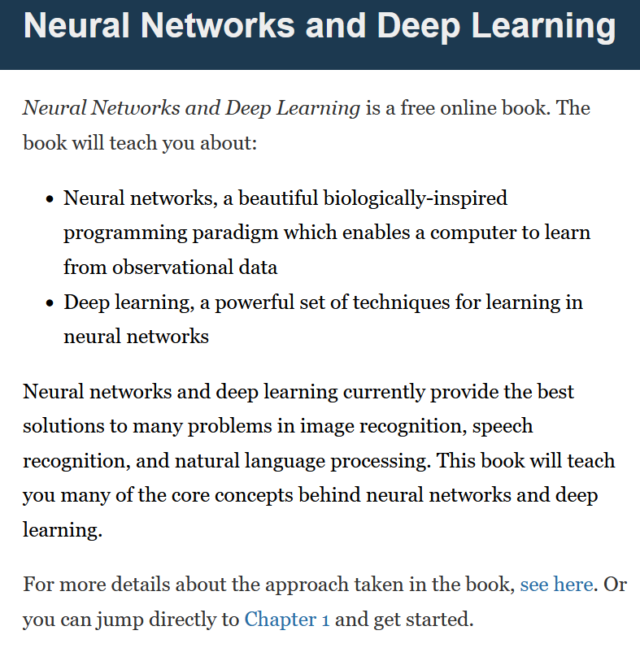
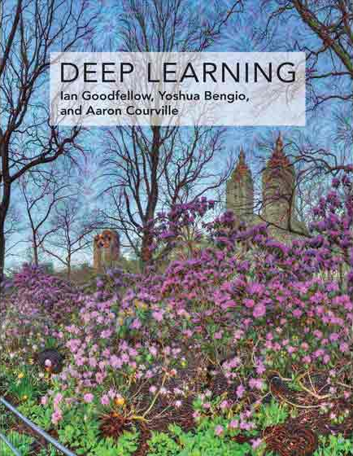

Supporting Textbooks
Supporting textbooks, for your curiosity (not needed to understand this course, just for reference).
Michael A. Nielsen, “Neural networks and deep learning”, 2015. (http://neuralnetworksanddeeplearning.com/)
Ian Goodfellow, Yoshua Bengio and Aaron Courville, “Deep learning”, 2016. (https://www.deeplearningbook.org/)
Stevens et al., “Deep Learning with PyTorch”, 2020. (https://www.manning.com/books/deep-learning-with-pytorch)

Slide 8
Evaluation and grading
Quiz at the end of Day 1 (30%): Simple MCQ to be taken online, after day 1, to be submitted by the end of this week.
Lab at the end of Day 2 (60%): A more technical implementation of the concepts seen in class on a real-life problem. To be submitted at the end of the next weekend. More details to follow.
Participation and Attendance (10%): Not punishing, as long as you attend classes, you should be fine!

Slide 9



Technical pre-requisites
Install Python 3, if you have not done so already (this course does use the C++/Java version of PyTorch).
Libraries needed (maybe more based on projects/homeworks): numpy, matplotlib, scipy, sklearn, torch, torchvision, torchmetrics, possibly more.
Jupyter notebooks for demos of code, along with the slides.
In doubt, you can always use Google Colab to run the codes.

Slide 10

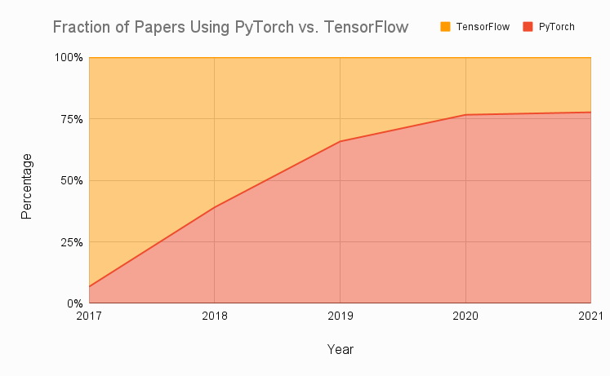
Technical pre-requisites
Framework of choice will be PyTorch! (not Tensorflow, not Keras, not MXNet, etc.)
Increasing popularity and preferred to Google’s Tensorflow these days for many reasons.
Learn more, if curious: https://www.assemblyai.com/blog/pytorch-vs-tensorflow-in-2022/
Also, this: https://arxiv.org/abs/2508.04035

Slide 11
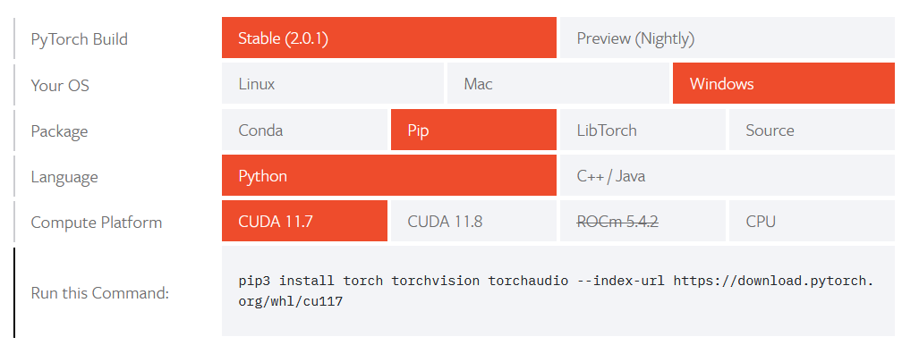
Installing PyTorch and CUDA
Install PyTorch, by getting the latest version (not the one shown below!) from https://pytorch.org/get-started/locally/
Setting up CUDA/GPU acceleration is always a good idea! (More details in bonus slides).

Slide 12
Practice of Deep Learning Day 1, Part 1/4
Matthieu De Mari

Slide 13
About this lecture
What are the typical concepts of Machine Learning to be used as a starting point for this course?
What are the different families of problems in Deep Learning?
What is the typical structure of a Deep Learning problem?
What is linear regression and how to implement it?
What is the gradient descent algorithm and how is it used to train Machine Learning models?

Slide 14
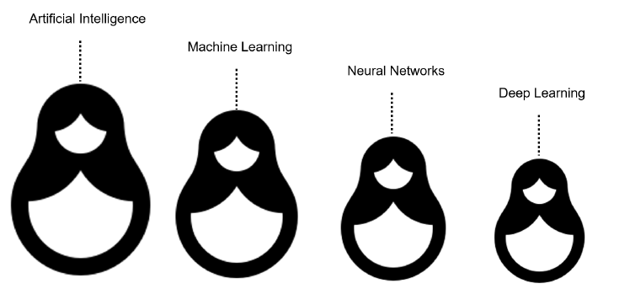
What is AI/ML/NN/DL?
Artificial intelligence
Machine Learning
Neural Networks
Deep Learning
Definition (Artificial Intelligence):
In Computer Science, Artificial Intelligence (AI) refers to the theory and development of computer systems capable to replicate/emulate the human brain, more specifically perform cognitive tasks that normally require human intelligence, such as visual perception, speech recognition, decision-making, and translation between languages.

Slide 15
What is AI/ML/NN/DL?
Conventional programming
Definition (Machine Learning):
In Computer Science, Machine Learning (ML) refers to the field of study that describes techniques and algorithms that give computers the ability to learn without being explicitly programmed.
Some implementations of machine learning may rely on data and neural networks.
Input (Given)
Function
(Created)
Output
(Obtained)
VS.
Machine Learning
Input (Available)
Function
(?)
Output
(Available)

Slide 16
What is AI/ML/NN/DL?
What we normally do in programming is to design functions,
which would do specific operations,
and return outputs,
for any input we could give it.
But sometimes, we can encounter problems where
we can easily find inputs and expected outputs,
but the function to be coded is not simple to figure out.
E.g., what animal in picture?
Input (Given)
Function
(Coded Manually)
Output
(Obtained)
Input (Available)
Function
(?)
Output
(Available)

Slide 17

What is AI/ML/NN/DL?
E.g., what animal is in the picture?
Typical problem in Computer Vision, called Image Recognition.
Input x (available)
Function f
(?)
Output y = f(x)
(available)
Very easy for a human…
But, how would we explain the logic of recognizing animals in pictures to a computer?
It’s a cat!

Slide 18
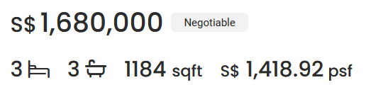
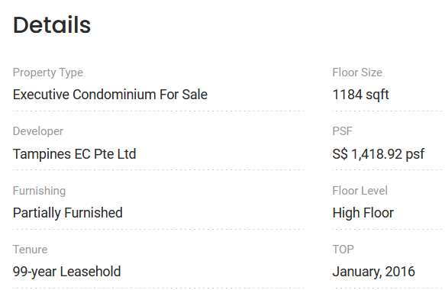

What is AI/ML/NN/DL?
Other scenarios have to do with tasks where there is no easy closed-form expression connecting some given inputs to expected outputs.
E.g., what is a good selling price for my appartment?
How would you guess the selling price of an appartment based on its parameters (size, location, etc.) and previous sales?
→ Typical Machine Learning Problems!

Slide 19
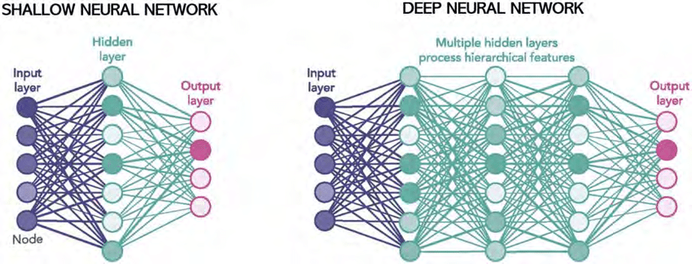
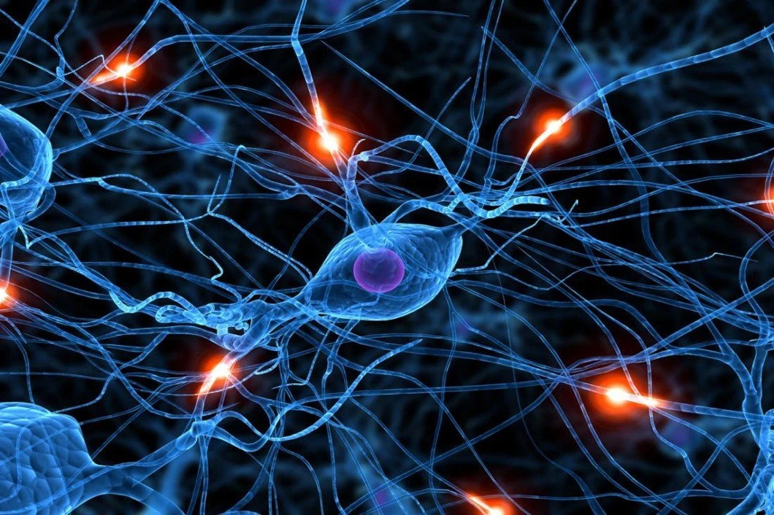
What is AI/ML/NN/DL?
Definition (Neural Networks):
Neural Networks (NNs) are computing systems inspired by the biological neural networks that constitute animal brains.
NNs are based on a collection of connected units (or nodes) called artificial neurons, which are a (loose) model for the neurons in a biological brain.
Each connection, like the synapses in a biological brain, can transmit a signal to other neurons, therefore processing any information given as inputs and producing a final signal as output.

Slide 20
What is AI/ML/NN/DL?
Definition (Deep Learning):
Deep Learning (DL) is a subfield of machine learning, and deep neural networks will typically make up the backbone of deep learning algorithms.
The number of node layers, or depth, of neural networks is what distinguishes a shallow neural network from a deep neural network, which must have more than three.

Slide 21
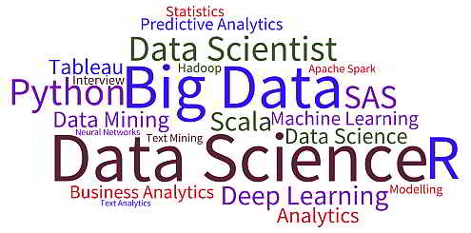
What is AI/ML/NN/DL?
Artificial intelligence
Machine Learning
Neural Networks
Deep Learning

Slide 22
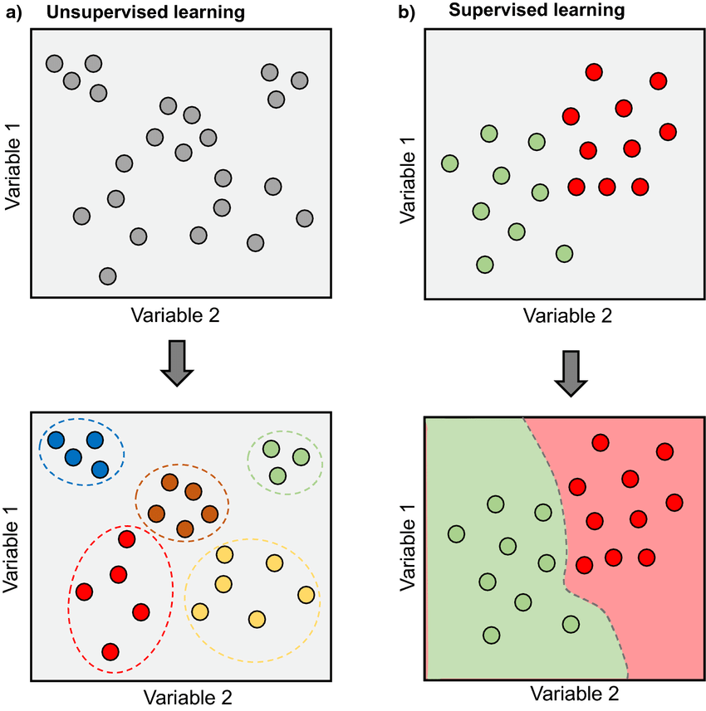
Supervised vs Unsupervised Learning
Definition (Supervised vs. Unsupervised Learning):
Supervised and Unsupervised Learning are the two techniques of ML.
The main difference is the need for labelled training data:
Supervised machine learning relies on labelled input and output data to learn and make predictions,
while unsupervised machine learning does not require labelled data.

Slide 23
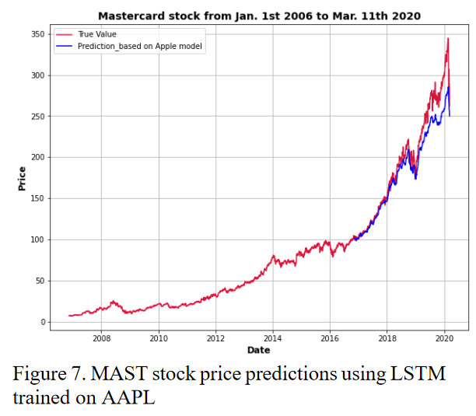
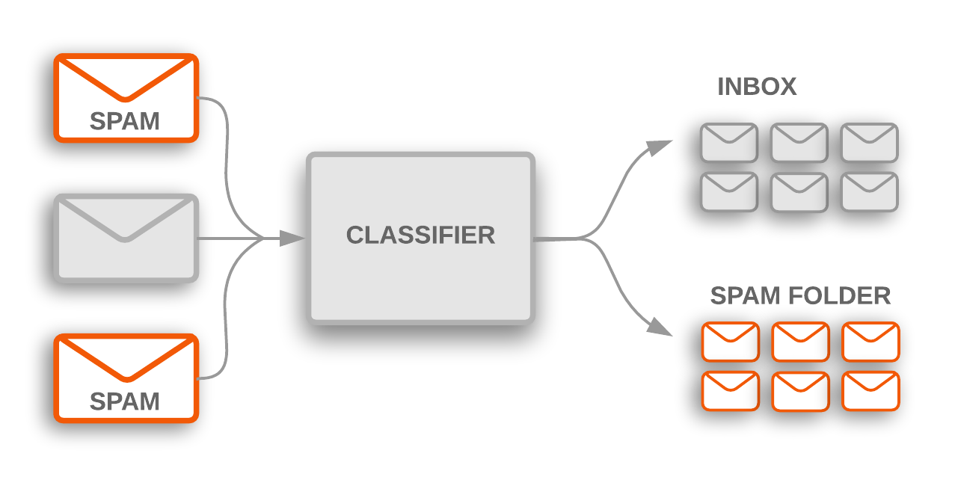
Supervised Learning Examples
Examples of supervised learning: spam detection, text classification, predicting the stock market, etc.

Slide 24
Regression vs. Classification (Supervised)
Definition (Classification):
Classification models are used to divide the samples in the dataset into different classes.
Classification algorithms are then used to predict/classify discrete or finite number values, such as Male or Female, True or False, Spam or Not Spam, etc.
In Classification, the outputs are discrete or categorical values.
It is a cat!

Slide 25
Regression vs. Classification
Definition (Regression):
Regression models are used to identify the relationships between the input and output variables.
Regression algorithms are used to predict continuous values such as price, salary, age, etc.
In regression, the outputs are often continuous numerical values, and not a finite list of possibilities.

Slide 26
Supervised Learning Examples
Example: predicting the market.
Question: is it a regression or a classification task?

Slide 27
Supervised Learning Examples
Example: predicting the market.
Question: is it a regression or a classification task?
Depends on you approach it.
If the output we are predicting is the value of the stock in the future, then it is a regression.
If the plan is to predict whether we should buy, sell or hold, then it is a classification.

Slide 28
Deep Learning and Supervised/Unsupervised
While it is possible to use Deep Learning models and Neural Networks to perform both Supervised and Unsupervised tasks…
The vast majority of DL/NN tasks fall in the category of supervised learning.
(And we will therefore mostly focus on that for now)

Slide 29
Elements of an ML problem
Definition (Elements of a ML problem):
Machine learning problems should be well-defined, i.e. the following elements must be clearly identified:
Task (T) at hand,
Inputs (I) and Outputs (O),
Model (M) definition and its trainable parameters (P),
Loss (L) function to measure the performance of current model on said task and dataset.

Slide 30
Our first toy example
Our first toy example: simplified version of the apartment price prediction.
Task (T) at hand:
Predict price of an apartment based on the apartment features.
We will generate a “fake” dataset consisting of apartments with features and selling prices.
It is a supervised regression task.

Slide 31
Our first toy example
Our first toy example: simplified version of the apartment price prediction.
Inputs (I) and Outputs (O):
Inputs will be a list of apartment features, which here will only consist of the surface of the apartment, in square meters (sqm).
Output will be the selling price in millions of SGD (mSGD).

Slide 32
Our first toy example (mock dataset)
Have a look at Notebook 1.
We will create a dataset, which uses surfaces as inputs, with values drawn randomly between 40 and 150 sqm.
We will assume that the price is randomly generated, using a uniform distribution, with:
Average price being 100000 + 14373 times the surface in sqm,
and a random "variation" of +/- 10% around the average value.

Slide 33
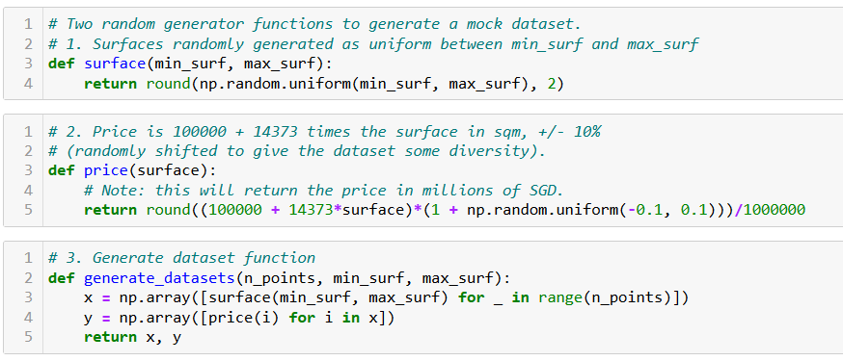
Our first toy example (mock dataset)

Slide 34
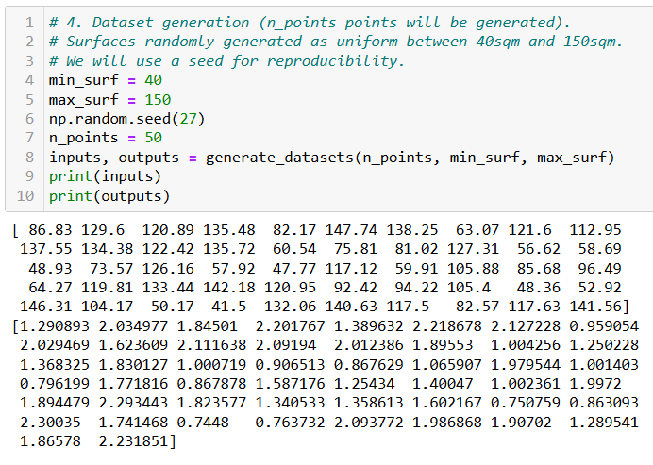
Our first toy example (mock dataset)

Slide 35
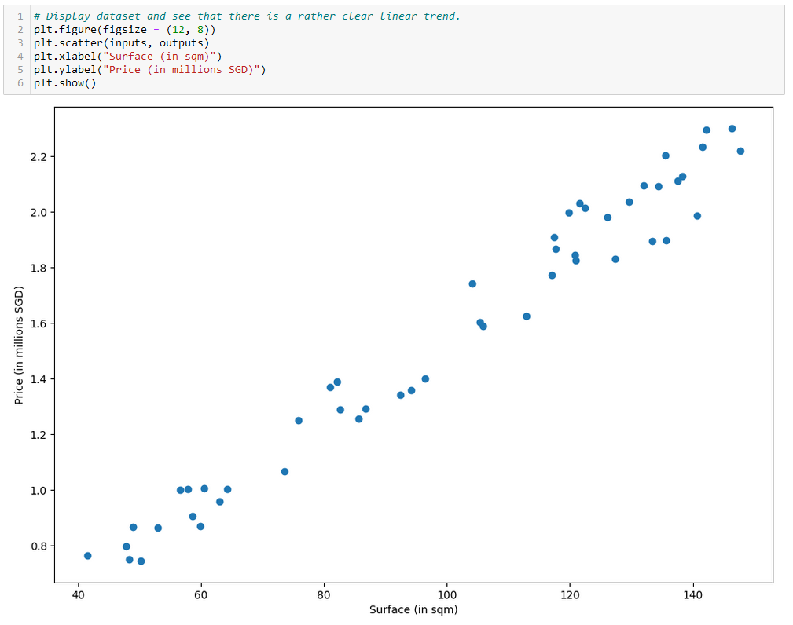

Slide 36
Our first toy example
Our first toy example: simplified version of the apartment price prediction.
Model (M) definition and its trainable parameters (P):
Here, our model will consist of a linear regression model.

Slide 37
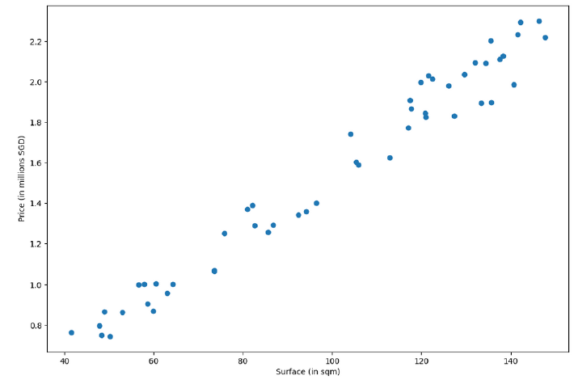
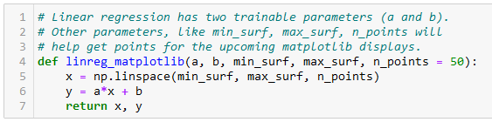
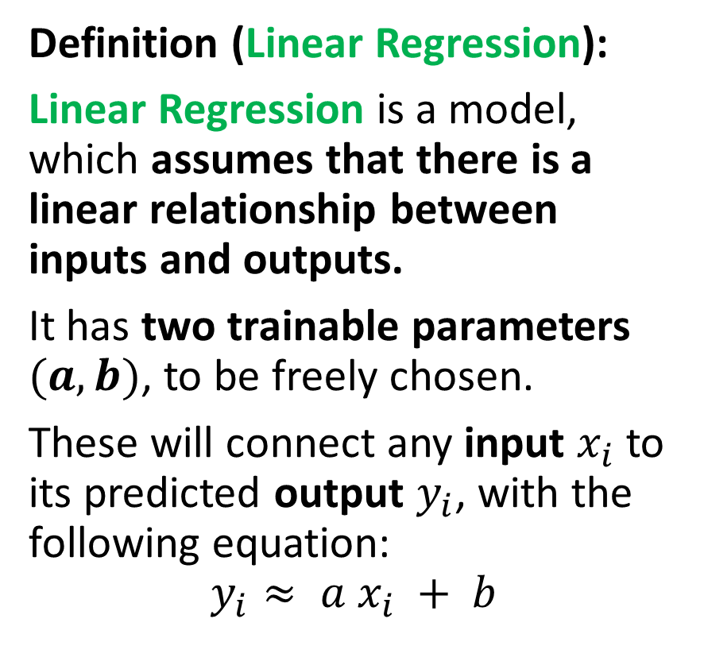
Our first model, the linear regression
Definition (Linear Regression):
Linear Regression is a model, which assumes that there is a linear relationship between inputs and outputs.
It has two trainable parameters $(a, b)$, to be freely chosen.
These will connect any input $x_{i}$ to its predicted output $y_{i}$, with the following equation:
$$y_{i}≈ a x_{i} + b$$

Slide 38
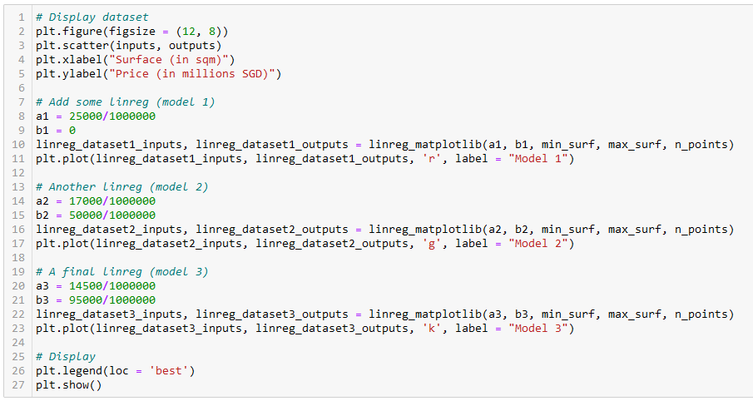
Let us try different values of (a, b)
Model 1 (red)
Model 2
(green)
Model 3
(black)

Slide 39
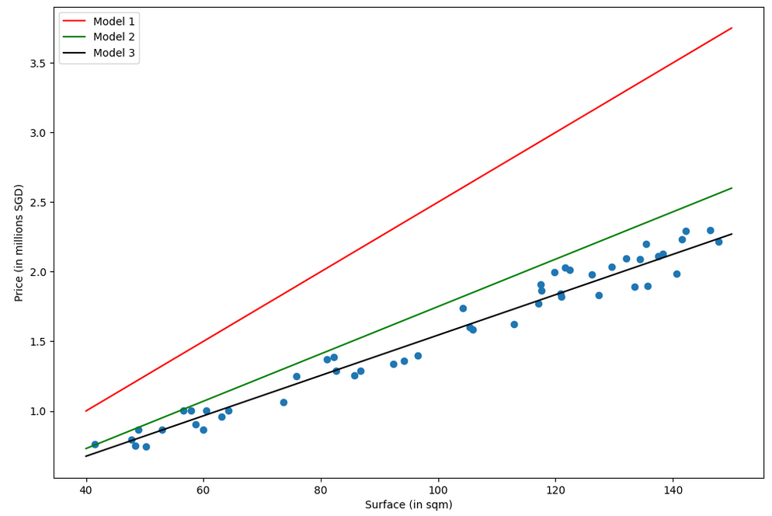
Which model is the best fit for this task in your opinion? (red, green or black?)
Why is one better than another?

Slide 40
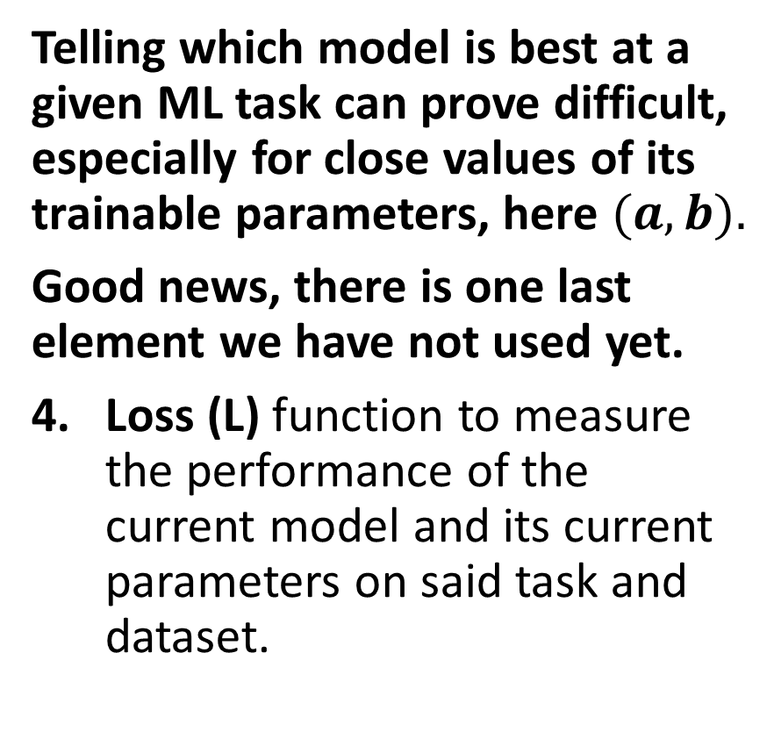
The need for a loss function
Which model is the best fit for this task in your opinion? (red, green or black?)
Why is one better than another?
Telling which model is best at a given ML task can prove difficult, especially for close values of its trainable parameters, here $(a, b).$
Good news, there is one last element we have not used yet.
Loss (L) function to measure the performance of the current model and its current parameters on said task and dataset.

Slide 41
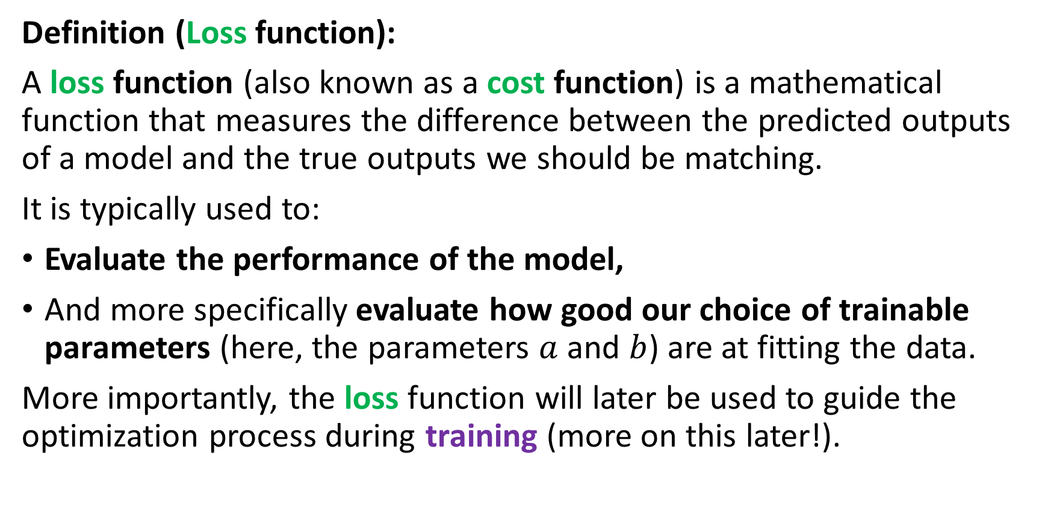
The need for a loss function
Definition (Loss function):
A loss function (also known as a cost function) is a mathematical function that measures the difference between the predicted outputs of a model and the true outputs we should be matching.
It is typically used to:
Evaluate the performance of the model,
And more specifically evaluate how good our choice of trainable parameters (here, the parameters $a$ and $b$) are at fitting the data.
More importantly, the loss function will later be used to guide the optimization process during training (more on this later!).

Slide 42
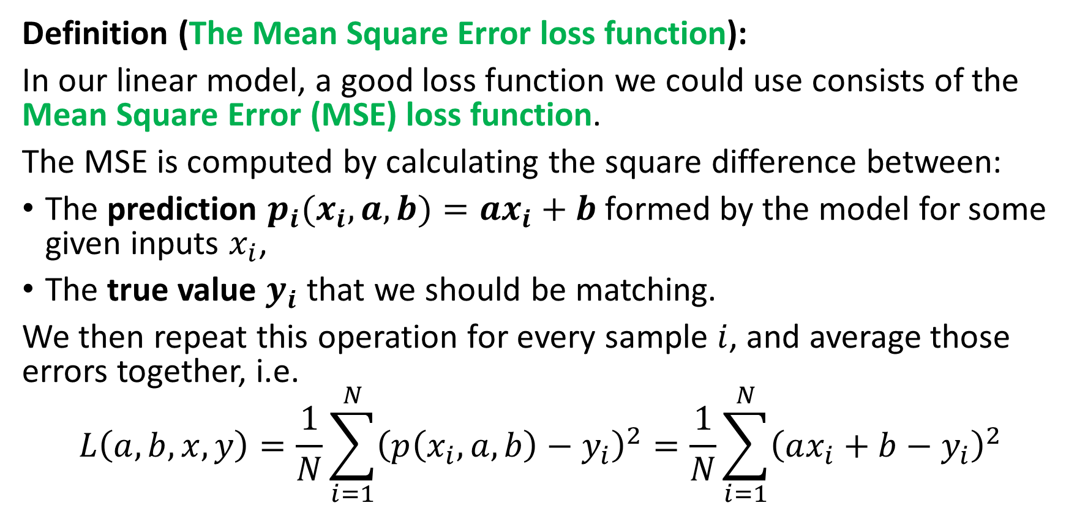
The need for a loss function
Definition (The Mean Square Error loss function):
In our linear model, a good loss function we could use consists of the Mean Square Error (MSE) loss function.
The MSE is computed by calculating the square difference between:
The prediction $p_{i}(x_{i},a,b)=ax_{i}+b$formed by the model for some given inputs $x_{i}$,
The true value $y_{i}$ that we should be matching.
We then repeat this operation for every sample $i$, and average those errors together, i.e.
$$L\left(a, b,x, y\right)=\frac{1}{N}\sum_{i=1}^{N}{{\left(p\left(x_{i}, a, b\right)−y_{i}\right)}^{2}}=\frac{1}{N}\sum_{i=1}^{N}{{\left(ax_{i}+b−y_{i}\right)}^{2}}$$

Slide 43
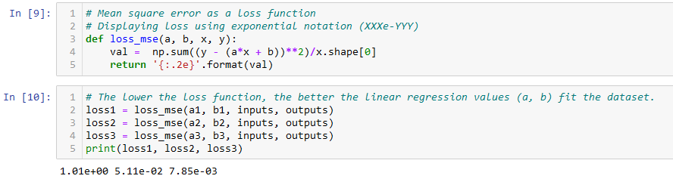

The need for a loss function
Recall the definition of the MSE loss function
$$L(a, b,x, y)=\frac{1}{N}\sum_{i=1}^{N}{{\left(ax_{i}+b−y_{i}\right)}^{2}}$$

Slide 44
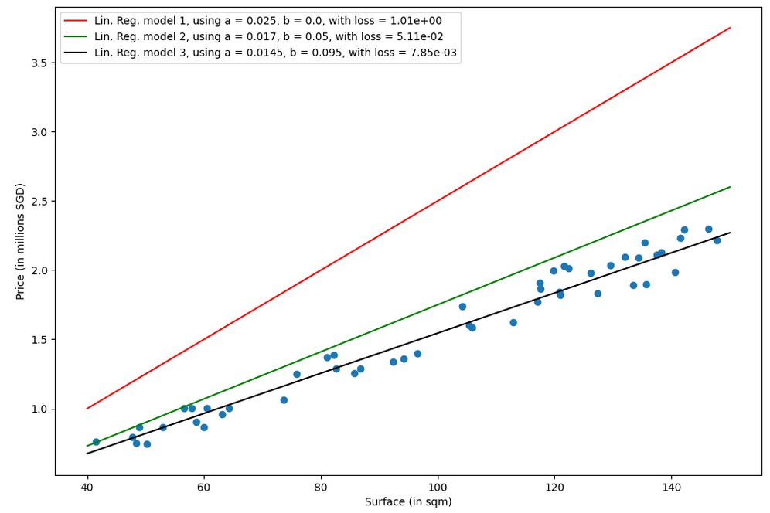
Which model is the best fit for this task in your opinion? (red, green or black?)
Why is one better than another?
Answer: Black model, because it has a lower loss value than the green and red ones!

Slide 45
Training a model
Definition (Training a model):
Training a model consists of finding the best values for the trainable parameters of the chosen model, for the given task and dataset.
By best values for the trainable parameters, we mean the values that minimize the chosen loss function. It is therefore an optimization problem of some sort!
Once a minimal value is obtained on the loss function, then we can claim that the “optimal” trainable parameters have been found.
Or in other words, that the model has been trained to solve its machine learning task.

Slide 46
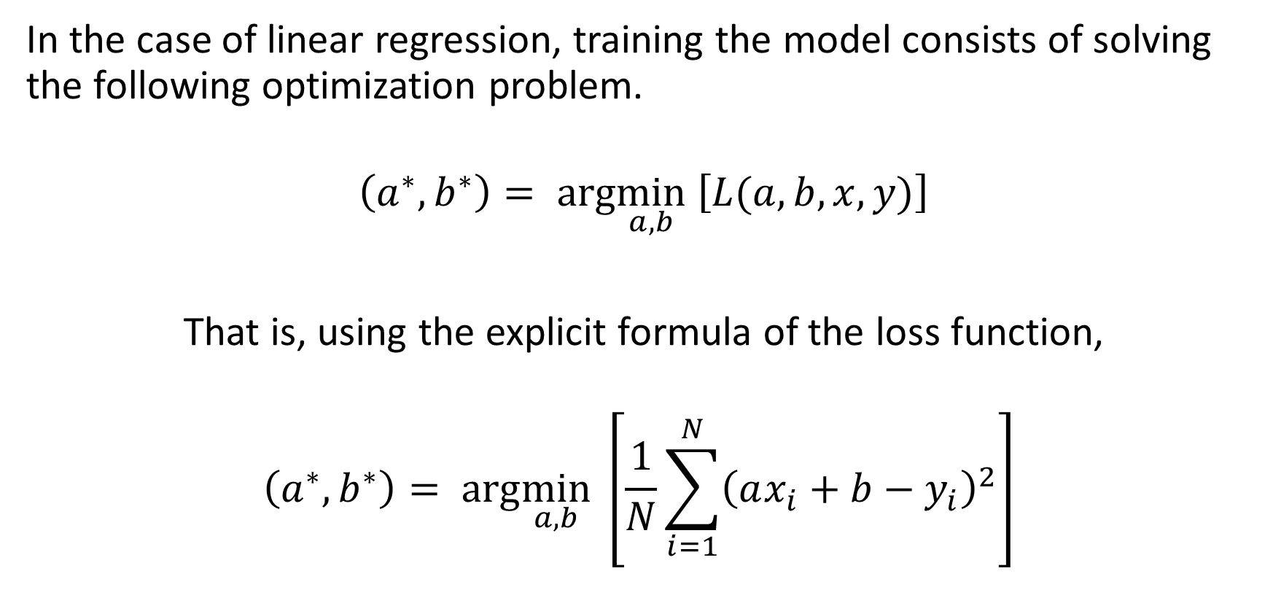
Training a linear regression model
In the case of linear regression, training the model consists of solving the following optimization problem.
$$\left(a^{∗},b^{∗}\right)= arg\min_{a,b} \left[L(a, b,x, y)\right]$$
That is, using the explicit formula of the loss function,
$$\left(a^{∗},b^{∗}\right)= arg\min_{a,b} \left[\frac{1}{N}\sum_{i=1}^{N}{{\left(ax_{i}+b−y_{i}\right)}^{2}}\right]$$

Slide 47
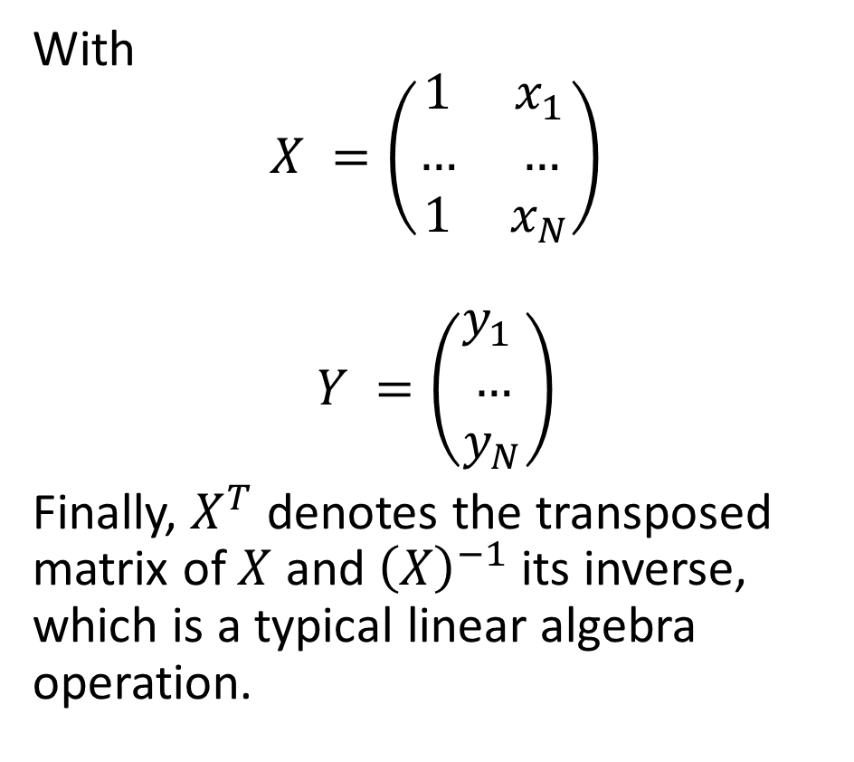
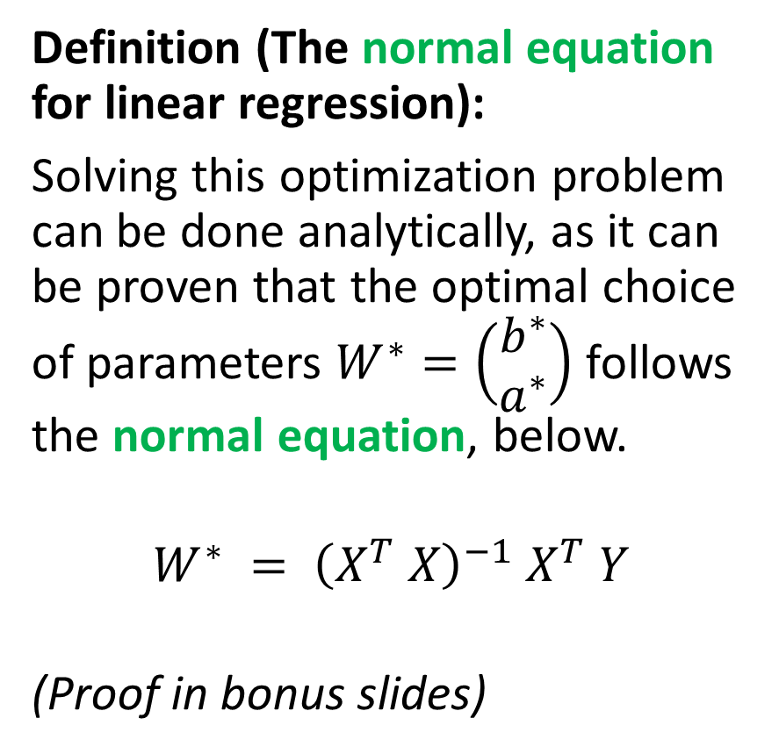
Training a linear regression model
Definition (The normal equation for linear regression):
Solving this optimization problem can be done analytically, as it can be proven that the optimal choice of parameters $W^{∗}=\left(\begin{matrix}b^{∗} \\ a^{∗}\end{matrix}\right)$ follows the normal equation, below.
$$W^{∗} = {\left(X^{T} X\right)}^{−1} X^{T} Y$$
(Proof in bonus slides)
With
$$X =\left(\begin{matrix}1 & x_{1} \\ … & … \\ 1 & x_{N}\end{matrix}\right)$$
$$Y =\left(\begin{matrix}y_{1} \\ … \\ y_{N}\end{matrix}\right)$$
Finally, $X^{T}$ denotes the transposed matrix of $X$ and ${\left(X\right)}^{−1}$its inverse, which is a typical linear algebra operation.

Slide 48
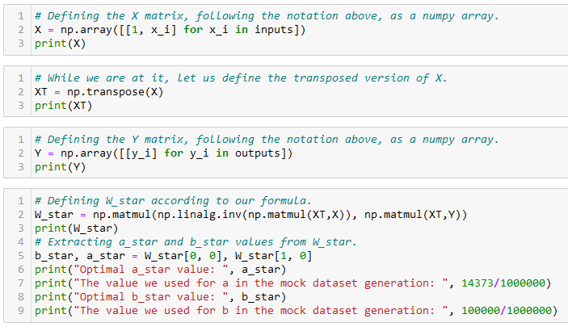

Training a linear regression model
Normal Equation: $W^{∗} = {\left(X^{T} X\right)}^{−1} X^{T} Y$

Slide 49
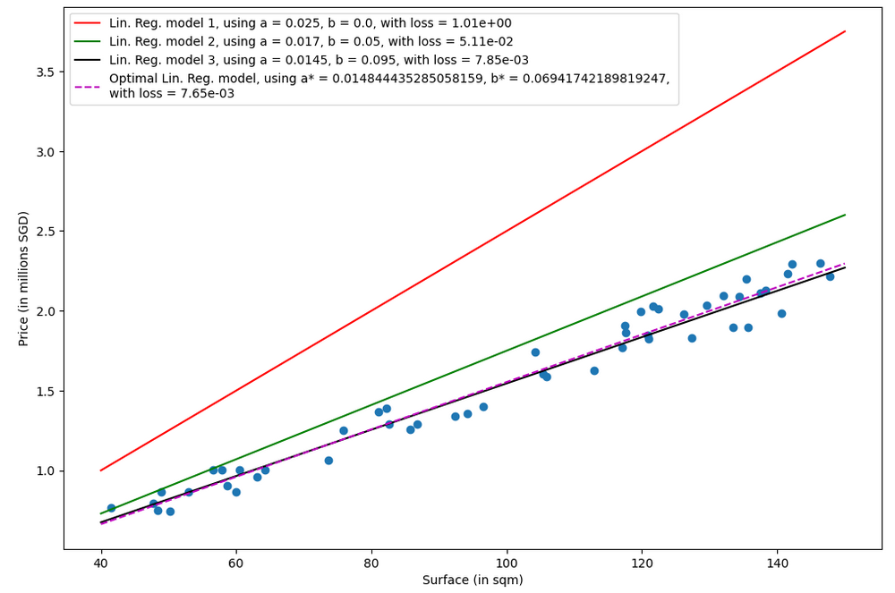
Purple line is the optimal set of parameters for our model on the given task and dataset!
Black was pretty close!

Slide 50
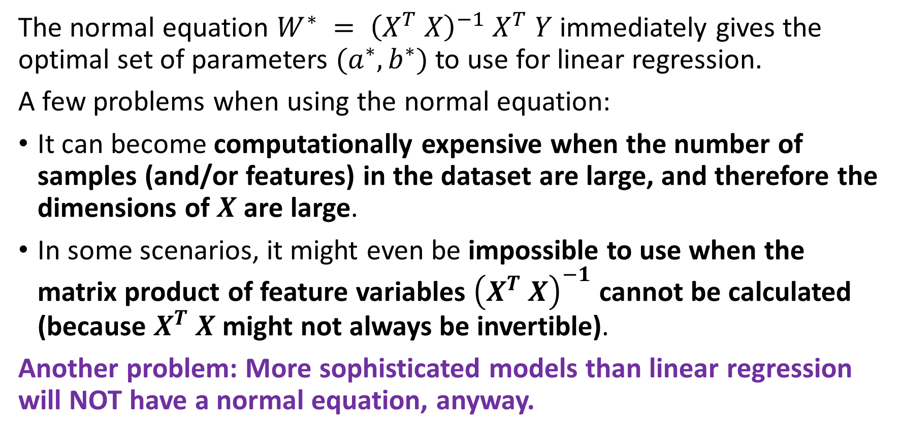
The problem with the normal equation
The normal equation $W^{∗} = {\left(X^{T} X\right)}^{−1} X^{T} Y$immediately gives the optimal set of parameters $(a^{∗}, b^{∗})$to use for linear regression.
A few problems when using the normal equation:
It can become computationally expensive when the number of samples (and/or features) in the dataset are large, and therefore the dimensions of $X$ are large.
In some scenarios, it might even be impossible to use when the matrix product of feature variables ${\left(X^{T} X\right)}^{−1}$ cannot be calculated (because $X^{T} X$might not always be invertible).
Another problem: More sophisticated models than linear regression will NOT have a normal equation, anyway.

Slide 51
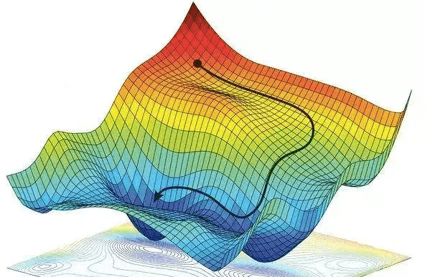
Gradient Descent, to the rescue!
Definition (Gradient Descent):
Gradient Descent (GD) is an iterative algorithm used to solve optimization problems.
It starts with an initial non-optimal set of parameters for our model.
It then repeatedly updates the parameters in the direction of the negative gradient of the given loss/cost function, until it converges to a local minimum.
Forgot about GD? Have a look at your notes from 10.013 M&A!

Slide 52
Gradient Descent, to the rescue!
Definition (Gradient Descent):
Gradient Descent (GD) is an iterative algorithm used to solve optimization problems.
It starts with an initial non-optimal set of parameters for our model.
It then repeatedly updates the parameters in the direction of the negative gradient of the given loss/cost function, until it converges to a local minimum.
The normal equation has many problems…
But GD, on the other hand can be used to find the optimal solution even when the normal equation is not applicable.
While sub-optimal, the main advantage of gradient descent is that it can handle very large datasets and it can also be used for non-linear models.

Slide 53
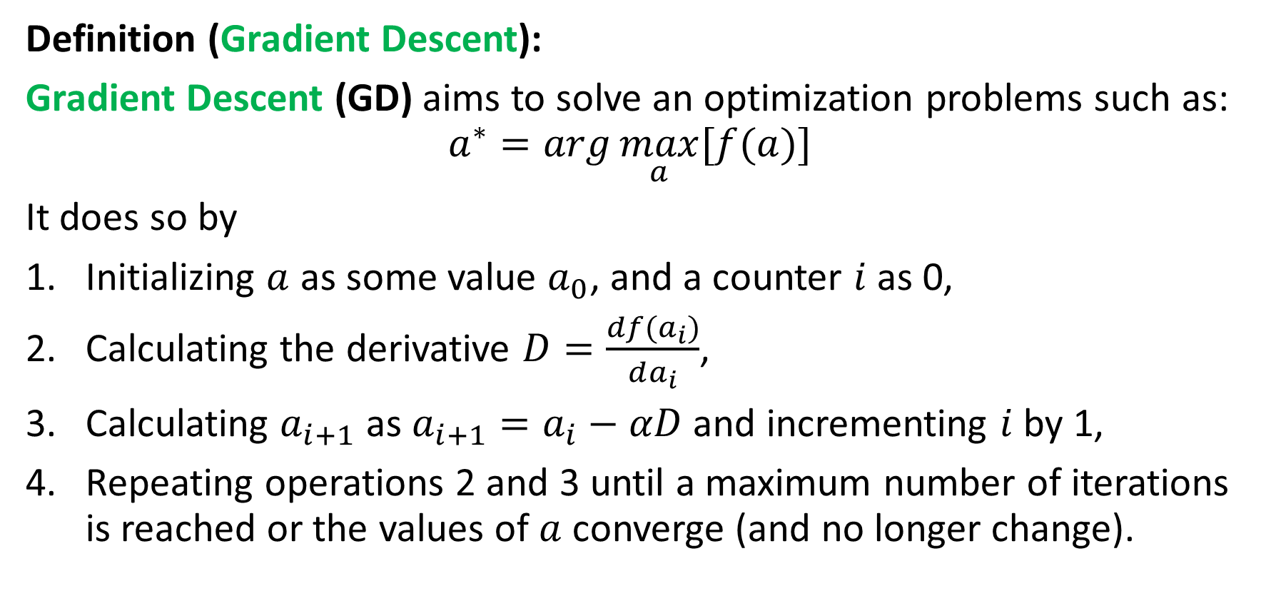
Gradient Descent, to the rescue!
Definition (Gradient Descent):
Gradient Descent (GD) aims to solve an optimization problems such as:
$$a^{∗}=arg\max_{a}{[f(a)]}$$
It does so by
Initializing $a$ as some value $a_{0}$, and a counter $i$ as 0,
Calculating the derivative $D=\frac{df(a_{i})}{da_{i}}$,
Calculating $a_{i+1}$ as $a_{i+1}=a_{i}−αD$ and incrementing $i$ by 1,
Repeating operations 2 and 3 until a maximum number of iterations is reached or the values of $a$ converge (and no longer change).

Slide 54
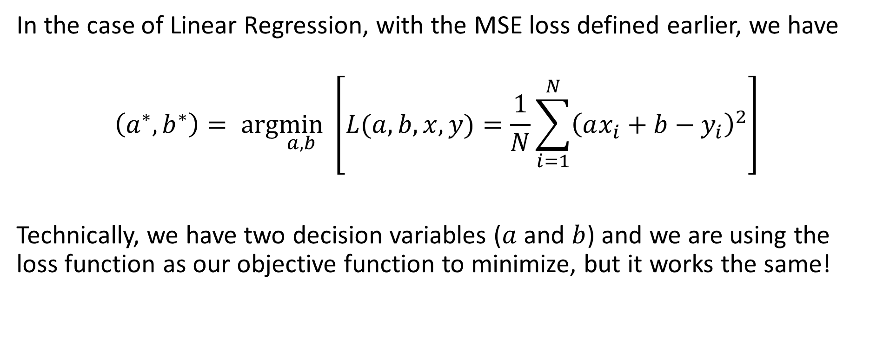
GD in Linear Regression
In the case of Linear Regression, with the MSE loss defined earlier, we have
$$\left(a^{∗},b^{∗}\right)= arg\min_{a,b} \left[L(a, b,x, y)=\frac{1}{N}\sum_{i=1}^{N}{{\left(ax_{i}+b−y_{i}\right)}^{2}}\right]$$
Technically, we have two decision variables ($a$ and $b$) and we are using the loss function as our objective function to minimize, but it works the same!

Slide 55
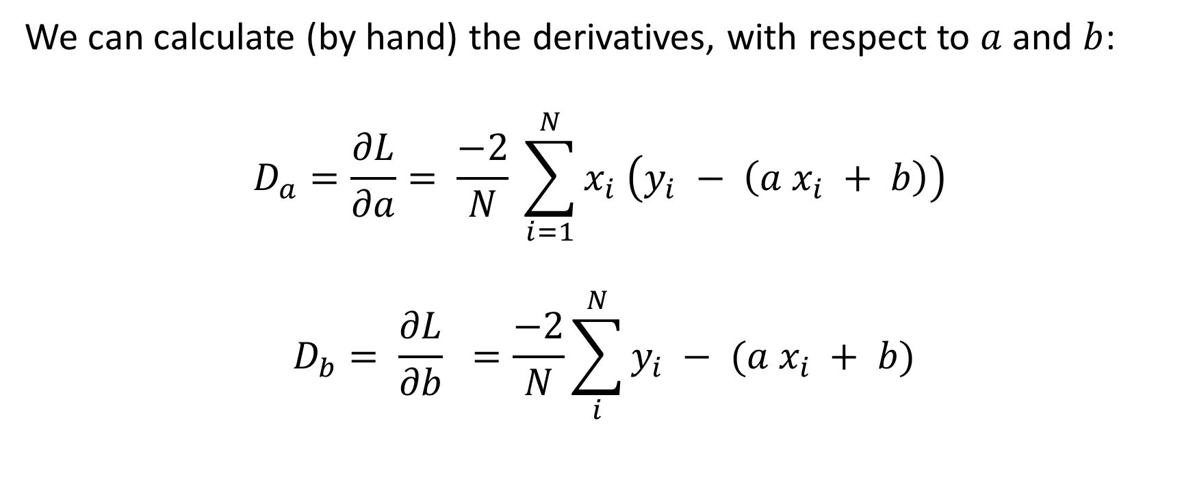
GD in Linear Regression
We can calculate (by hand) the derivatives, with respect to $a$ and $b$:
$$D_{a}=\frac{∂L}{∂a}= \frac{−2}{N} \sum_{i=1}^{N}{x_{i} \left(y_{i} − \left(a x_{i} + b\right)\right)}$$
$$D_{b}= \frac{∂L}{∂b} =\frac{−2}{N}\sum_{i}^{N}{y_{i} − (a x_{i} + b)}$$

Slide 56
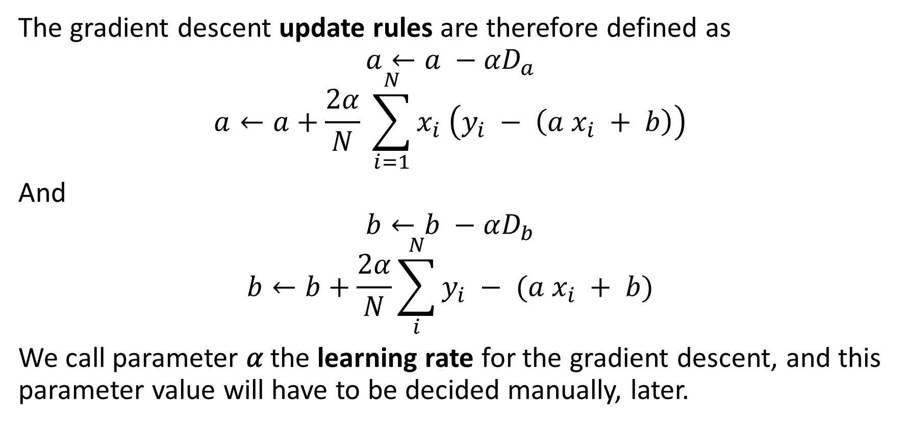
GD in Linear Regression
The gradient descent update rules are therefore defined as
$$a←a −{αD}_{a}$$
$$a←a+\frac{2α}{N} \sum_{i=1}^{N}{x_{i} \left(y_{i} − \left(a x_{i} + b\right)\right)}$$
And
$$b←b −αD_{b}$$
$$b←b+\frac{2α}{N}\sum_{i}^{N}{y_{i} − (a x_{i} + b)}$$
We call parameter 𝛼 the learning rate for the gradient descent, and this parameter value will have to be decided manually, later.

Slide 57
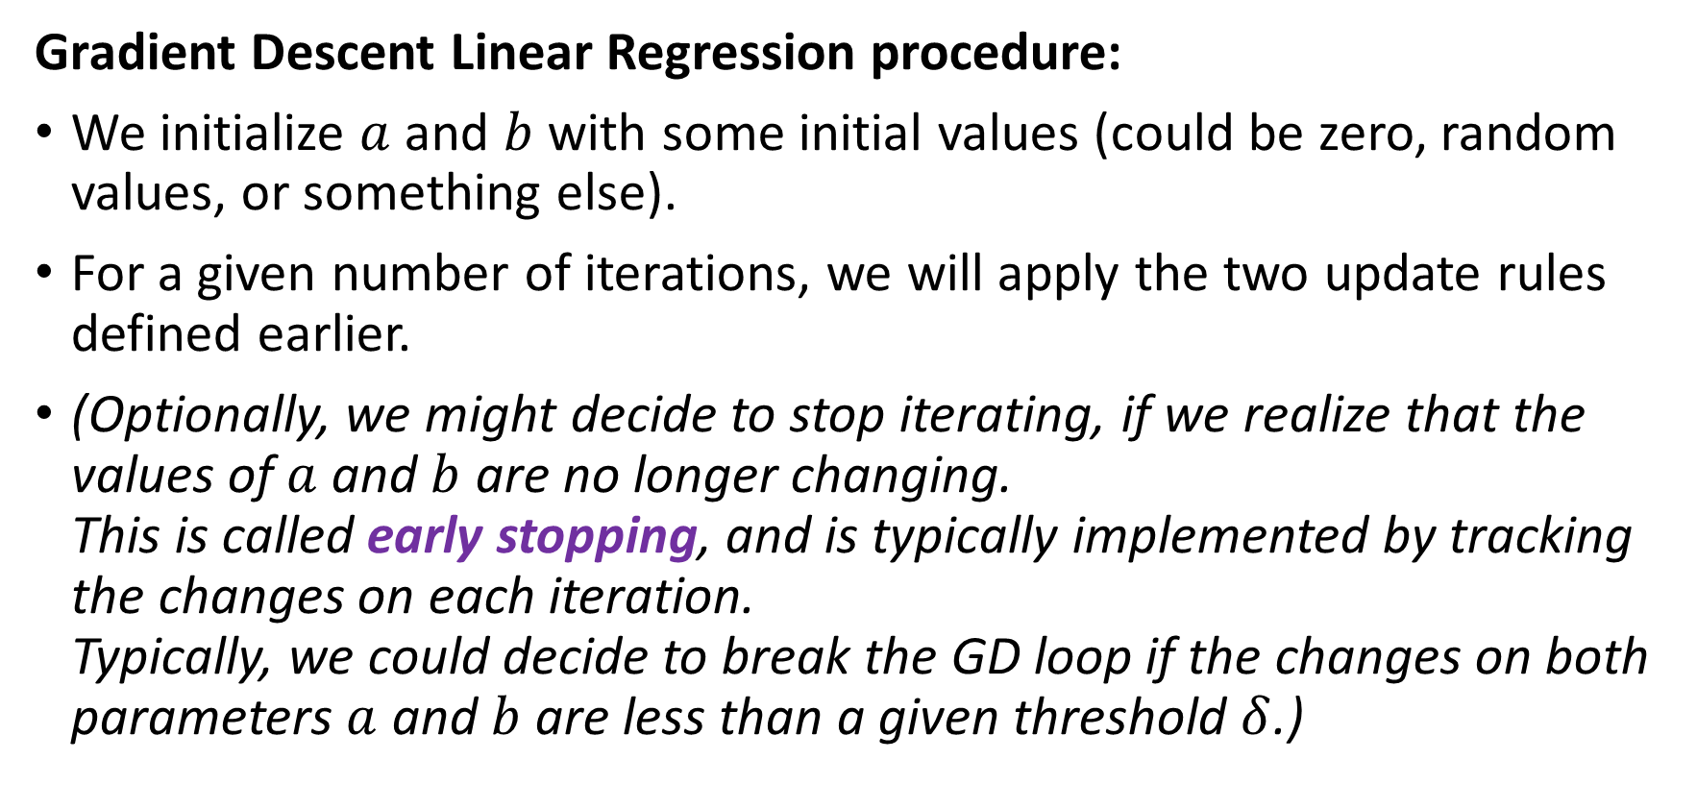
GD in Linear Regression
Gradient Descent Linear Regression procedure:
We initialize $a$ and $b$ with some initial values (could be zero, random values, or something else).
For a given number of iterations, we will apply the two update rules defined earlier.
(Optionally, we might decide to stop iterating, if we realize that the values of $a$ and $b$ are no longer changing. This is called early stopping, and is typically implemented by tracking the changes on each iteration. Typically, we could decide to break the GD loop if the changes on both parameters $a$ and $b$ are less than a given threshold $δ$.)

Slide 58
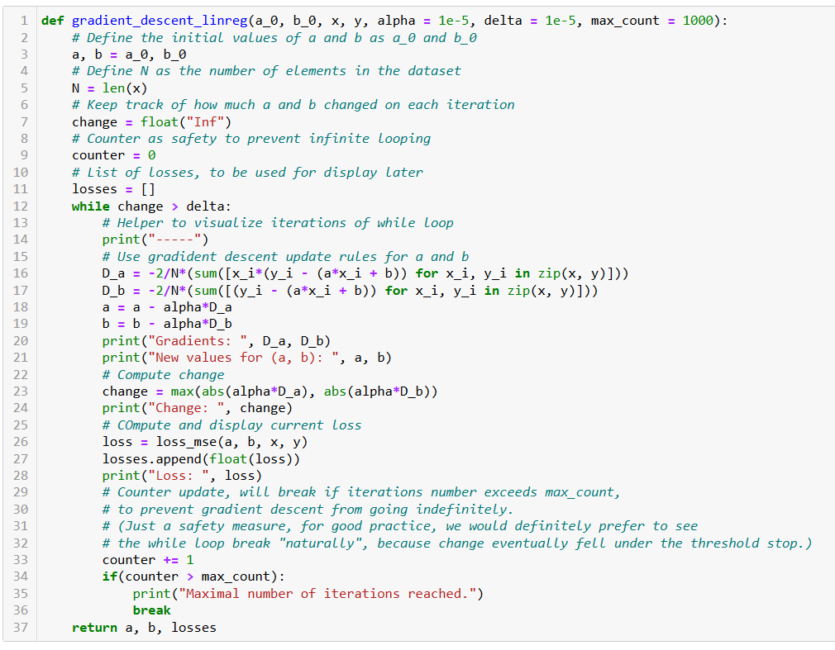
Initialize a and b as you please.

Slide 59
Number of samples in dataset.

Slide 60
Two possible stopping conditions, change < delta or counter > max_count.

Slide 61
Update using our GD update rules from earlier.

Slide 62
Compute change on this iteration (to decide on early stopping if changes become insignificant).

Slide 63
Calculate new MSE value using the new parameters of a and b. We also keep track of these loss values by adding them to a list, used for display later.

Slide 64
Return trained parameters and loss values list on each iteration.

Slide 65
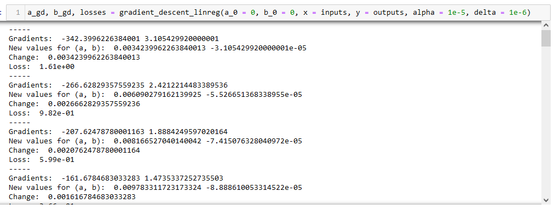
Observation: Loss is decreasing over iterations (which is good news for us!)

Slide 66
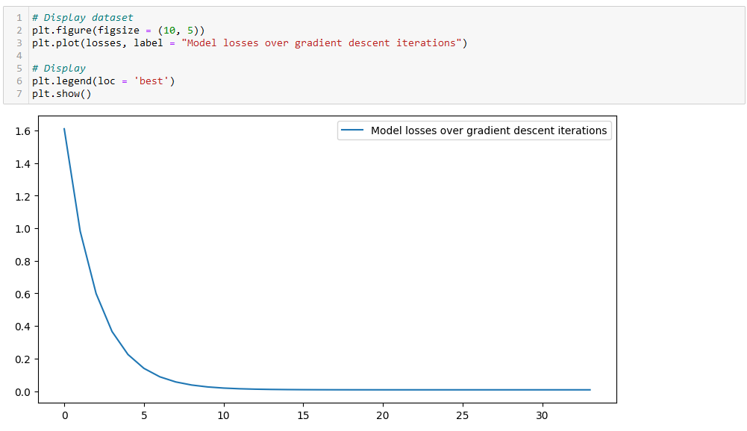
Observation: Confirmed with a plot. Loss is decreasing over iterations (which is good news for us!)
Even seems to converge to a minimum value, corresponding to the optimal set of trainable parameters?

Slide 67
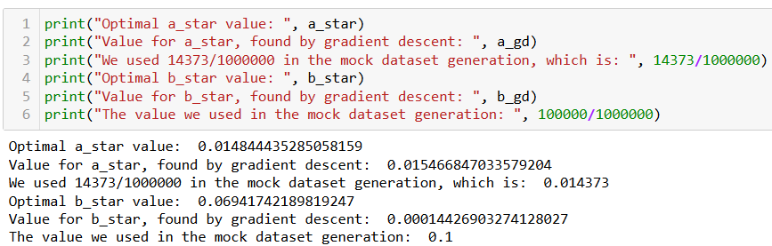

Checking for optimal parameters
We have generated the dataset ourselves, so we know the optimal values for $a$ and $b$! (And we can even compute using the normal equation anyway…)

Slide 68
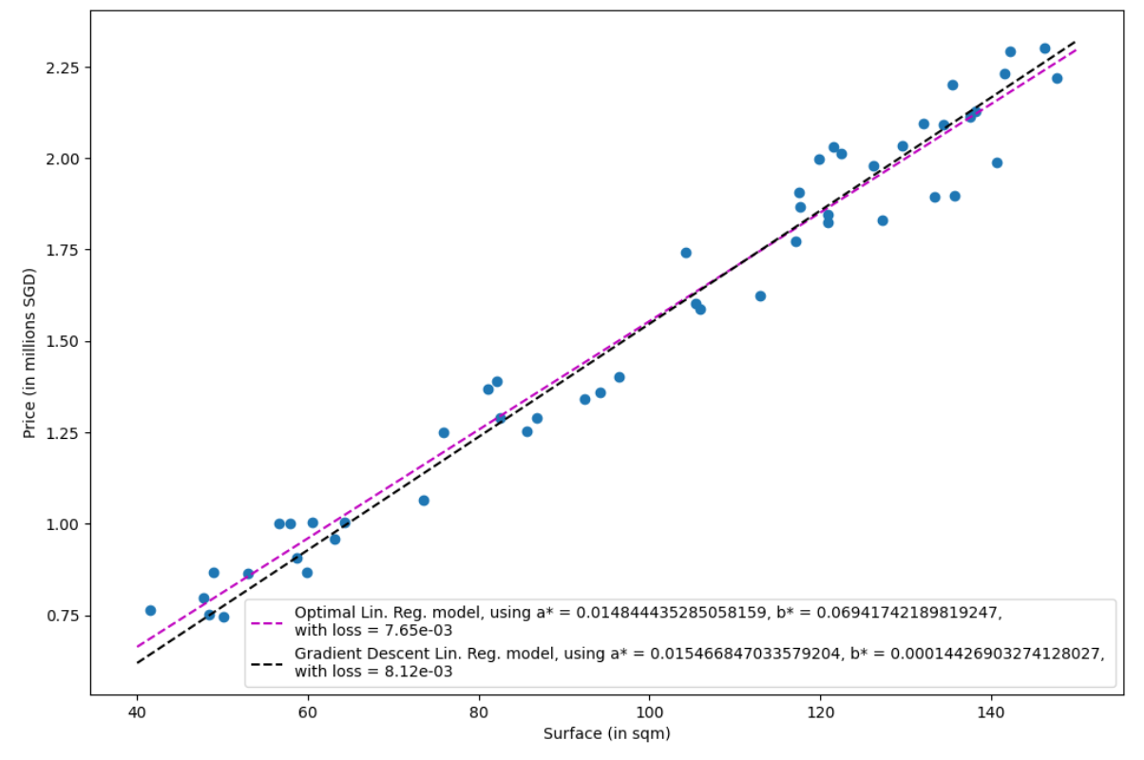
Observation: Close match, good enough for us. (Maybe could get better results with more iterations of GD?)

Slide 69
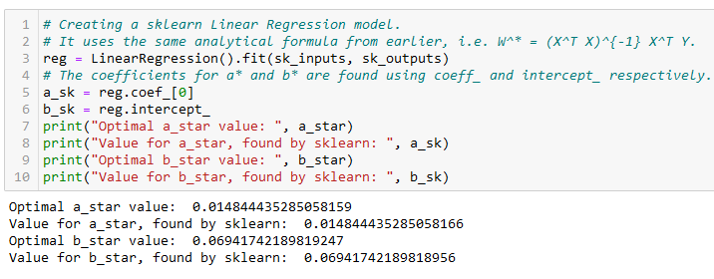
Using Sklearn for Linear regression
In practice, we never implement the linear regression model ourselves (but like many other things in CS, it is a good practice to try it once!)
It is often better/faster to rely on the sklearn library and use the LinearRegression object!

Slide 70
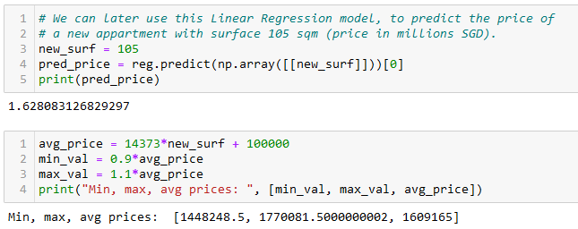
Predicting using Sklearn Linear regression
After training, it is also good practice to check if the predictor makes sense, by testing it and asking it to predict the price of an apartment it has never seen before.
Confirm the pertinence of predicted values manually, if possible.

Slide 71
Let us call it a break for now
We will continue on the next lecture with more ML reminders. (Bonus slides after this)

Slide 72

Installing PyTorch and CUDA
Check if your GPU is in the list of acceptable GPUs. https://developer.nvidia.com/cuda-gpus
If so, install CUDA (check that you CUDA version number matches the one of your PyTorch install!) https://developer.nvidia.com/cuda-downloads

Slide 73

Installing PyTorch and CUDA
Question: How to use CUDA with MacOS?
Efforts are being made to make GPU computing compatible with AMD and MacOS GPUs, but not the best (afaik).

Slide 74
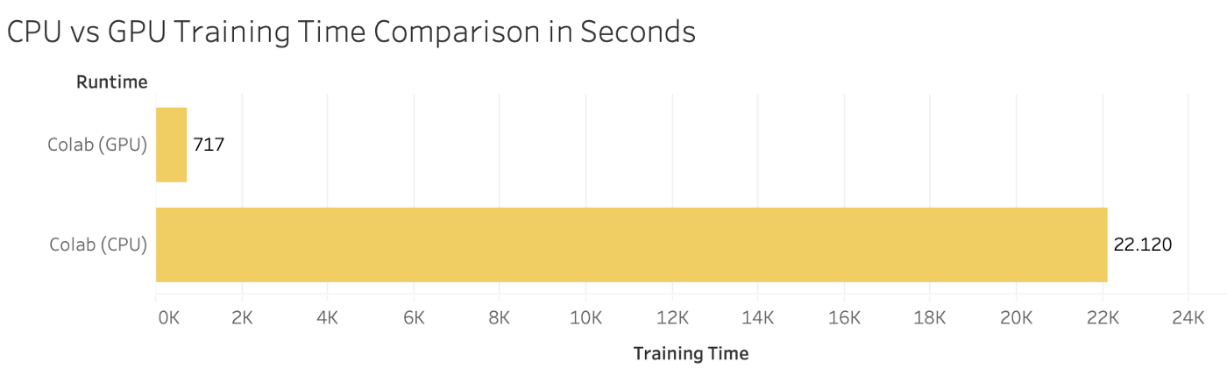

Installing PyTorch and CUDA
Your GPU not in the list of CUDA-enabled GPUs?
You bought a MacOS laptop?
Most notebooks can still run on CPU (but they might take significantly longer to run).
Also, always the option of using Google Colab, or create an education account on AWS.

Slide 75
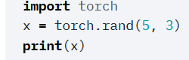


Checking your PyTorch and CUDA install
Hello World for PyTorch: to check you have PyTorch installed correctly. The code below should run and display a tensor.
Hello World for CUDA: to check you have correctly installed CUDA on top of PyTorch. The code below should print True, as the output of torch.cuda.is_available()

Slide 76

A quick word about PyTorch 2.0
PyTorch v2.0 is the current (latest version released in March 2023).
Should be fully retro-compatible.
Revising and testing notebooks (they were designed last year and tested on v1.13).
Kindly let me know if you have any issues!
Will let you know about new v2.0 features on W13.

Slide 77
Supervised vs Unsupervised Learning
Definition (Supervised vs. Unsupervised Learning):
Supervised and Unsupervised Learning are the two techniques of ML.
The main difference is the need for labelled training data:
Supervised machine learning relies on labelled input and output data to learn and make predictions,
while unsupervised learning does not require labelled data.

Slide 78

Unsupervised Learning Examples
Examples of unsupervised learning: clustering customers based on their behaviours, segmenting images, and identifying topics in a document.

Slide 79


Unsupervised Learning Examples
Identify topics that seem to appear in those papers and their prominence
Examples of unsupervised learning: clustering customers based on their behaviours, segmenting images, and identifying topics in a document.

Slide 80
Clustering vs. Association (Unsupervised)
Definition (Clustering vs. Association):
Unsupervised learning can be used for two types of problems: Clustering and Association.
The main difference is that
clustering groups data based on similarity,
while association looks for relationships between variables.

Slide 81
Clustering vs. Association (Unsupervised)
Examples of clustering:
Group customers into clusters based on the similarities in their purchasing behaviours, such as their spending habits or types of products they like.
Group the catalogue of movies available on Netflix and identify what movies have in common, so you can later recommend a movie to a user based on what he/she has seen before.

Slide 82




Clustering vs. Association (Unsupervised)
Example of association:
Finding the relationship between customer buying behaviors and customer satisfaction.
Association can be used to understand how changes in customer behavior impacts customer satisfaction, such as if buying a certain product increases customer satisfaction (or the opposite).

Slide 83


Proof of the Normal Equation
Using the notations
$$X =\left(\begin{matrix}1 & x_{1} \\ … & … \\ 1 & x_{N}\end{matrix}\right),$$
$$Y =\left(\begin{matrix}y_{1} \\ … \\ y_{N}\end{matrix}\right),$$
$$W^{∗}=\left(\begin{matrix}b^{∗} \\ a^{∗}\end{matrix}\right)$$
We have, in matrix form
$$XW^{∗}=\left(\begin{matrix}a^{∗}x_{1}+b^{∗} \\ … \\ a^{∗}x_{N}+b^{∗}\end{matrix}\right)$$
And, then it follows that
$$XW^{∗}−Y=\left(\begin{matrix}a^{∗}x_{1}+b^{∗} −y_{1} \\ … \\ a^{∗}x_{N}+b^{∗}−y_{N}\end{matrix}\right)$$

Slide 84

Proof of the Normal Equation
Our loss function, the MSE $L$, is therefore defined, in matrix format as:
$$L=\frac{1}{N}{\left(XW^{∗}−Y\right)}^{T}\left(XW^{∗}−Y\right)$$
This is equivalent to
$$L=\frac{1}{N}\left({\left(XW^{∗}\right)}^{T}−Y^{T}\right)\left(XW^{∗}−Y\right)$$

Slide 85

Proof of the Normal Equation
We then get
$$L=\frac{1}{N}\left({W^{∗}}^{T}X^{T}−Y^{T}\right)\left(XW^{∗}−Y\right)$$
Expanding
$$L=\frac{1}{N}({W^{∗}}^{T}X^{T}XW^{∗}−Y^{T}XW^{∗}− {W^{∗}}^{T}X^{T}Y+Y^{T}Y)$$

Slide 86

Proof of the Normal Equation
Recall that we are trying to find the solution to optimization problem
$$\left(a^{∗},b^{∗}\right)=arg\min_{a,b}\left[L(a, b,x, y)\right]$$
With
$$L=\frac{1}{N}({W^{∗}}^{T}X^{T}XW^{∗}−Y^{T}XW^{∗}−{W^{∗}}^{T}X^{T}Y+Y^{T}Y)$$
Recognizing that $Y^{T}XW^{∗}={W^{∗}}^{T}X^{T}Y$, differentiating our function $L$with respect to $W$ and equating it to zero gives:
$$\frac{∂L}{∂W}=\frac{1}{N}\left({2X}^{T}XW−2X^{T}Y\right)=0$$

Slide 87

Proof of the Normal Equation
This is equivalent to
$$\left(X^{T}XW^{∗}−X^{T}Y\right)=0$$
Or,
$$X^{T}XW^{∗}=X^{T}Y$$
Assuming $X^{T}X$ is invertible (and that might not always be the case based on your dataset!), this finally gives:
$$W^{∗}={\left(X^{T}X\right)}^{−1}X^{T}Y$$

